Slide 1
Predicting Recidivism in Released Prisoners in the State of Iowa
James M. Irving, Ph.D.

Slide 2
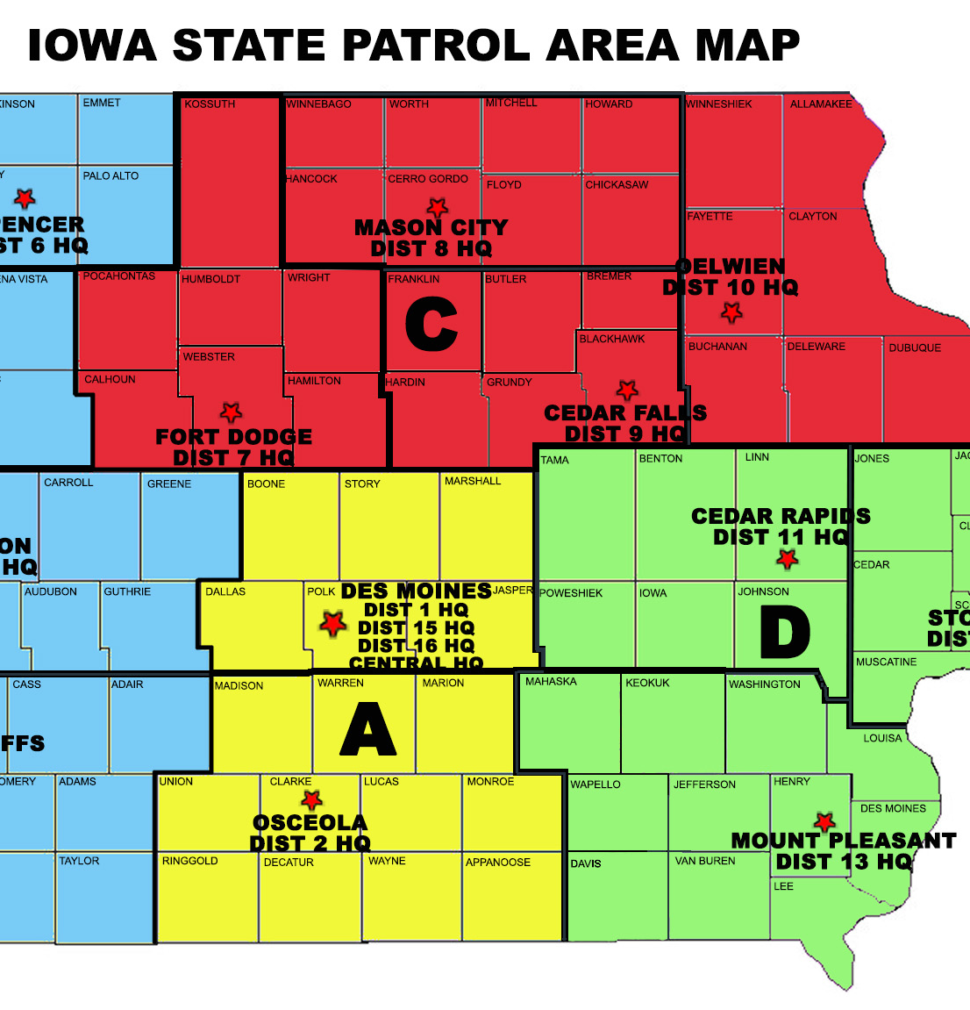
Data Source: Iowa Dept. of Corrections
Features Analyzed:
Fiscal Year Released
Recidivism Reporting Year
Race - Ethnicity
Convicting Offense Classification
Convicting Offense Type
Convicting Offense Subtype
Release Type
Main Supervising District
Recidivism - Return to Prison
Part of Target Population

